Slide 1
Team Hotwheels Self-Driving Car
Alexander Garcia
Kolton Speer

Slide 2
Motivation
Roughly 100 people die in car accidents every day in America alone
Self Driving cars have the potential to help cut emissions
Increased mobility for people who can’t drive
Children and Seniors
Handicapped

Slide 3

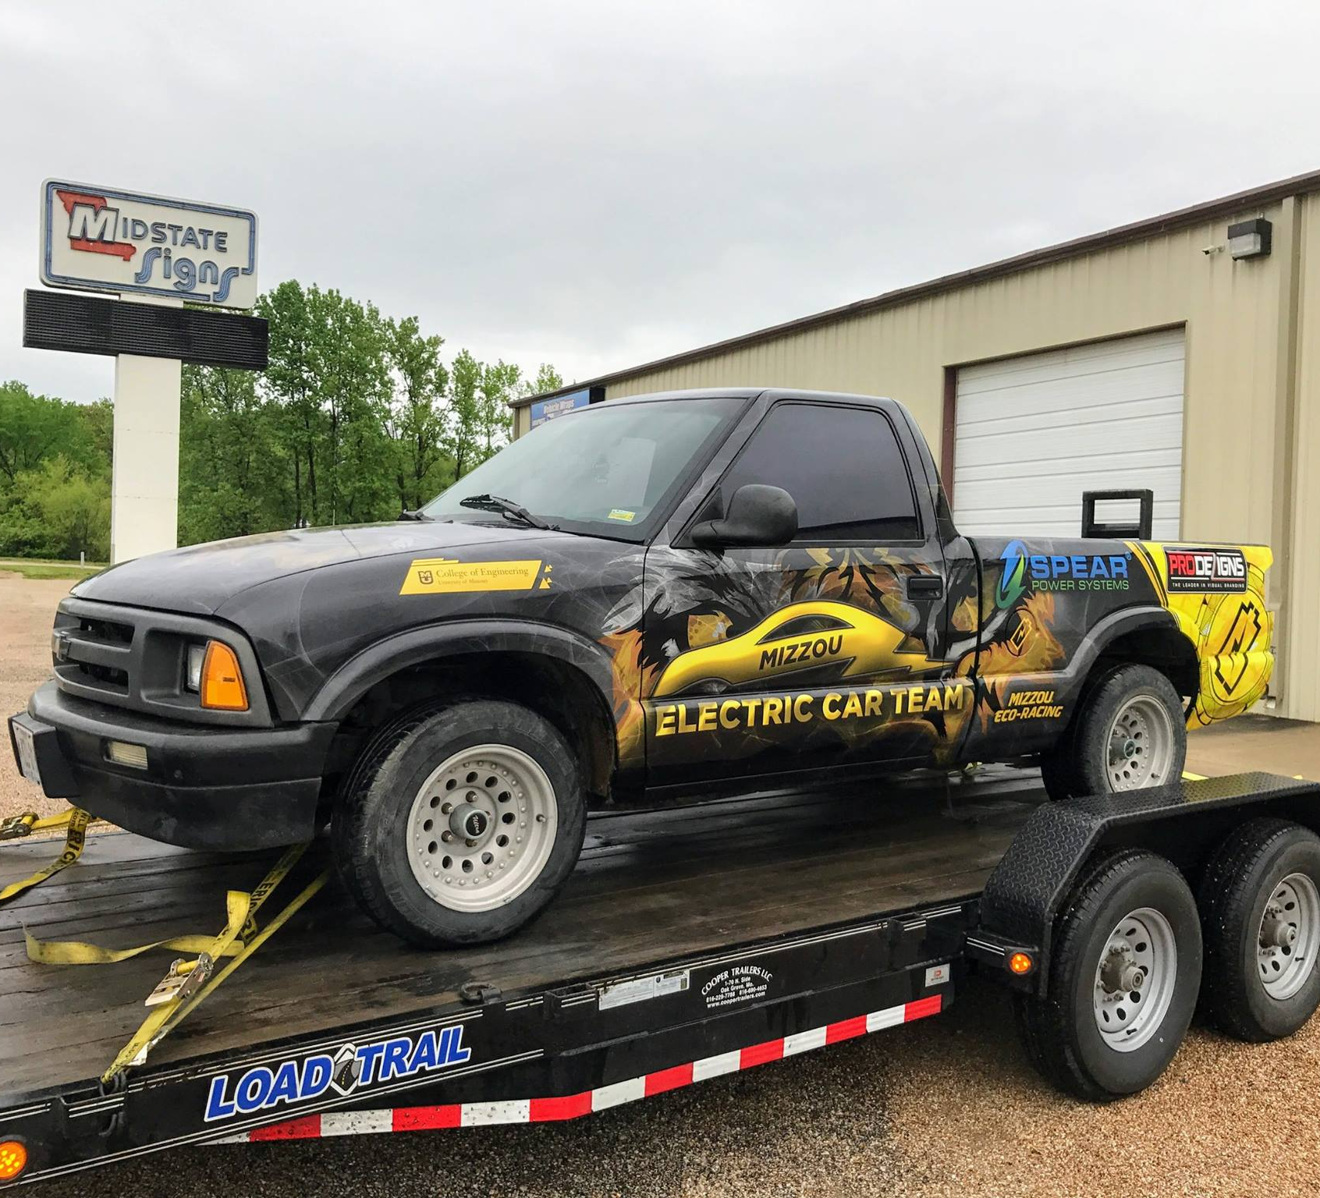

The Platform
Mizzou Eco Racing
Electric Chevy S-10 Pickup
Small
Has a bed

Slide 4
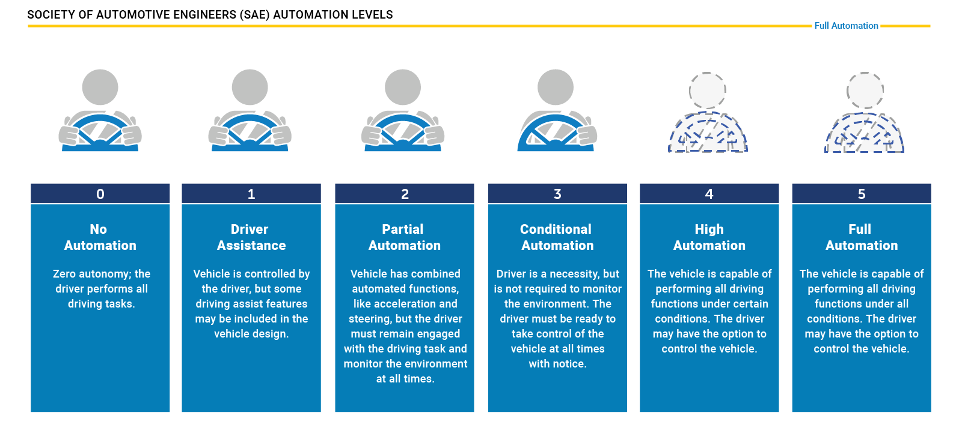
SAE Levels of Autonomy

Slide 5
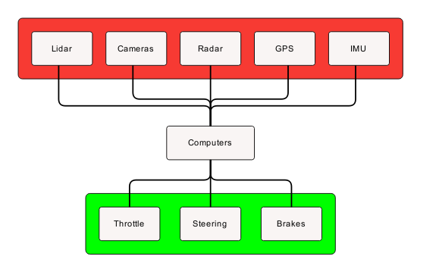

Implementation Overview
Perception
Cameras, Lidar/Radar, Positioning
Control
Computers, ROS
Action
Steering, Brakes, Throttle

Slide 6
Perception
Cameras
Object detection and path planning
Lidar
Object detection and distance detection
Radar
Emergency braking
GPS/IMU
Path planning and localization

Slide 7
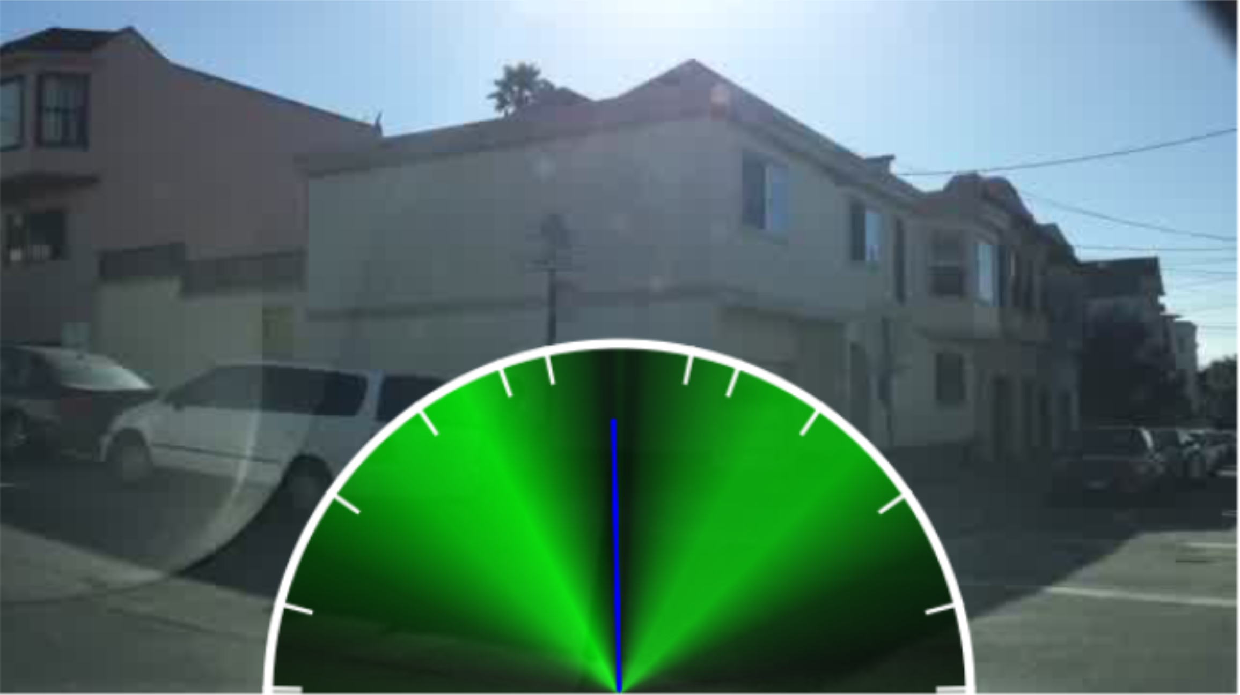
Path Planning
GPS mapping for general path
Cameras and deep learning model to find drivable area along that general path
Berkley Deep Drive dataset
End to End model based on Berkley and Nvidia models
Model makes a decision, we adjust with other information

Slide 8
Software Stack
Python 3.5, C, C++
Tensorflow
Neural Network library from Google
CUDA
Parallel computing library from Nvidia
Used in training, but most likely will not be used on board
OpenCV
Open source Computer Vision library
Robot Operating System
Asynchronous message passing

Slide 9
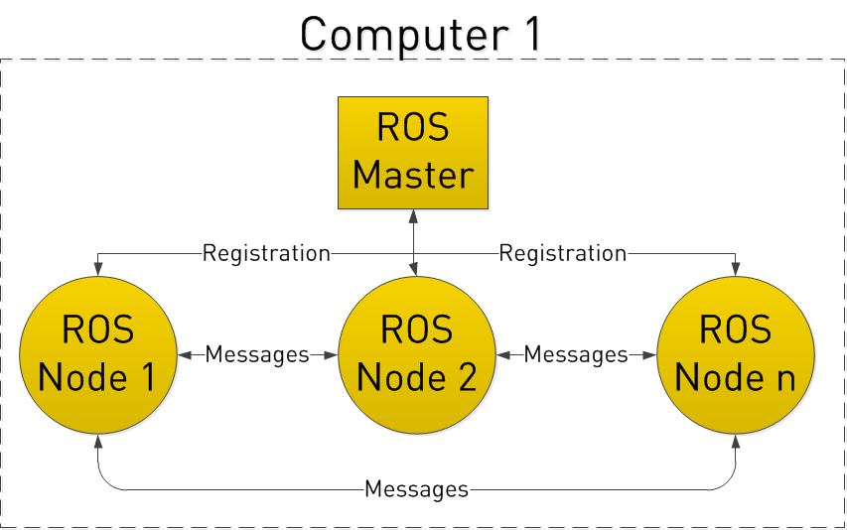

Control
Robot Operating System
Publisher subscriber model
Node for each sensor and perception service
Computers
2 or 3 computers onboard depending on sensor load
24 GB of ram
2.9GHz i7 processor
Solid State Hard drive
Training models on High Performance Computing cluster
Models are slow to train, but fast at prediction time

Slide 10
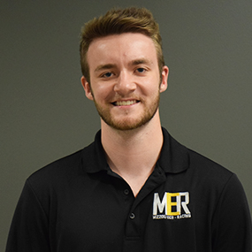
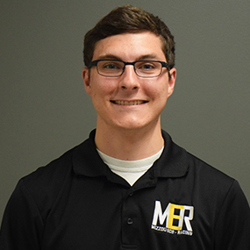
Action
Actuators on steering column, throttle, and brakes
Actuation systems designed by mechanical engineering students
Kyle Messick
Teddy Perkins

Slide 11
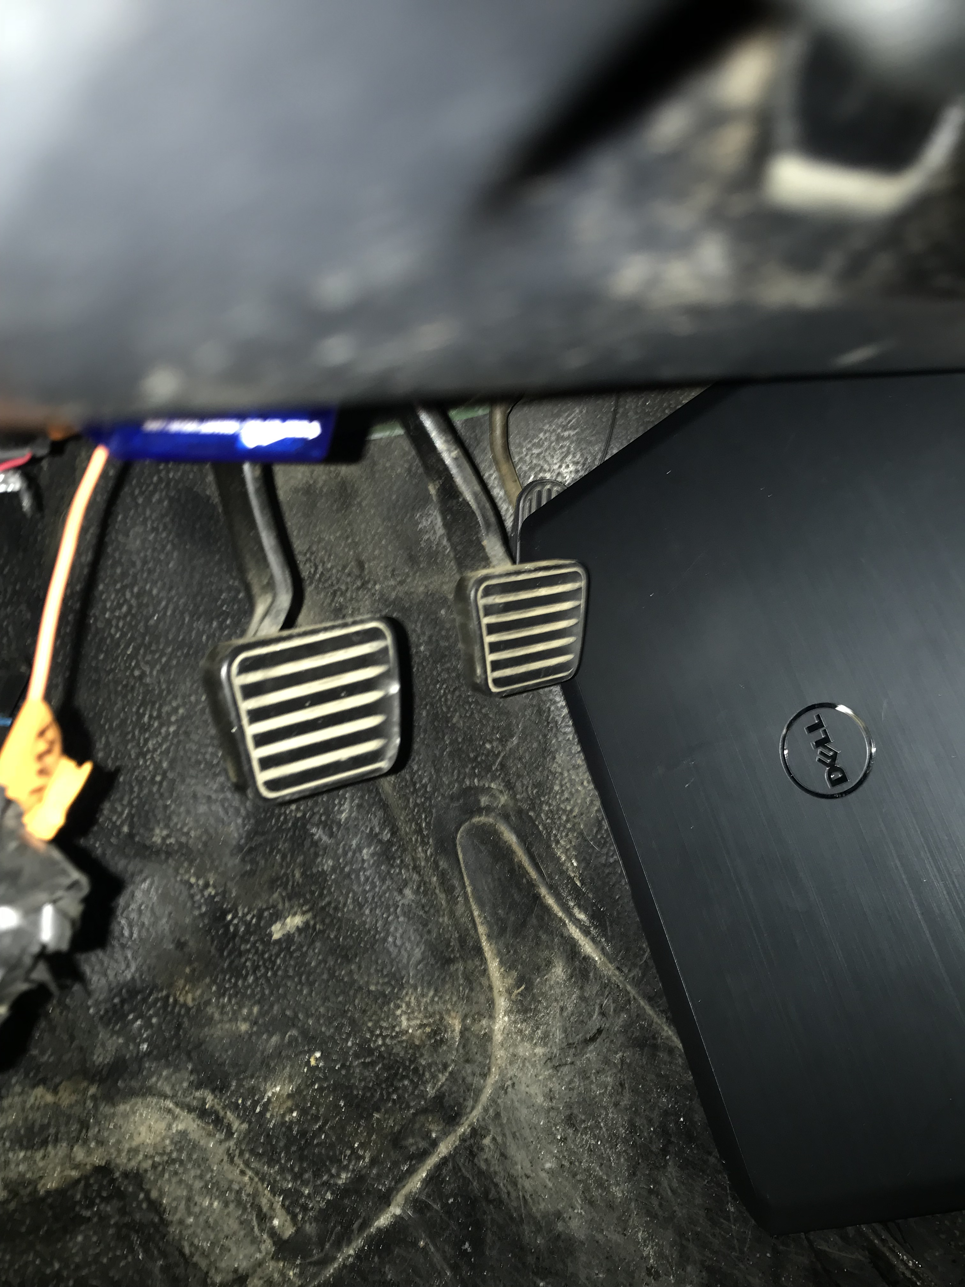
Last Resort
Still self driving but only stops on impact and NO control of steering. Wear a seatbelt….or two.
Technological due to the laptop pressing the accelerator instead of a brick.

Slide 12
Questions?

